Slide 1
HW5 Uninformed Search Practice
Breadth-first, depth-first, iterative-deepening, and uniform-cost

Slide 2
SUMMARY OF EXAMPLES
IN-CLASS
HOMEWORK
U1 breadth-first
U1 depth-first
U1 iterative deepening
U4 depth-first
U4 iterative deepening
U5 depth-first
U5 uniform cost
U2 breadth-first
U2 depth-first
U2 iterative deepening
U3 breadth-first
U3 depth-first
U6 depth-first
U6 uniform cost

Slide 3
In-Class Examples
Uninformed Search

Slide 4
U1: Breadth-First
E
SELECT | NEW NODES | FRINGE
 |  | E
E | B, S, A | B, S, A
B | N | S, A, N
S | T, F | A, N, T, E
A | - | N, T, F
N | - | T, F
T | D, W | F, D, W
F*
B
S
A
N
T
F
D
W
Notes:
Breadth-first
Depth-first
Iterative Deepening

Slide 5
U1: Depth-First
E
SELECT | NEW NODES | FRINGE
 |  | E
E | B, S, A | B, S, A
B | N | S, A, N
N | - | A, S
S |  | A, T, F
T | - | T, F
D | D, W | F, D, W
W
F*
B
S
A
N
T
F
D
W
Notes:
Breadth-first
Depth-first
Iterative Deepening

Slide 6
U1: Iterative Deepening
E
LIMIT | SELECT | NEW NODES | FRINGE
1 |  |  | E
 | E | B, S, A | B, S, A
 | B | - | S, A
 | S | - | A
 | A | - | -
2 |  |  | E
 | E | B, S, A | B, S, A
 | B | N | N, S, A
 | N | - | S, A
 | S | T, F | T, F, A
 | T | - | F, A
 | F*
B
S
A
N
T
F
D
W
Notes:
Breadth-first
Depth-first
Iterative Deepening

Slide 7
U3: Iterative-Deepening
P
C
R
LIMIT | SELECT | NEW NODES | FRINGE
1 |  |  | A
 | A | C, R | C, R
 | C | - | R
 | R | - | -
2 |  |  | A
 | A | C, R | C, R
 | C | G | G, R
 | G | - | R
 | R | Z, M | Z, M
 | Z | - | M
 | M*
G
Z
M
H
Y
X
S
I
F
T
D
W
Notes:
Depth-first
Breadth-first
Iterative-deepening

Slide 8
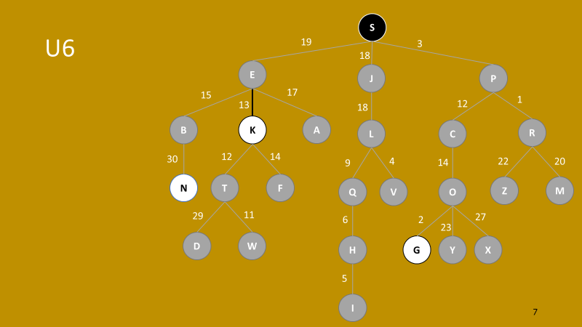
W
U4: Breadth-First
4
4
E
X
4
SELECT | NEW NODES | FRINGE
 |  | Q
Q | E, R, T | E, R, T
E | W | R, T, W
R | X | T, W, X
T | Y | W, X, Y
W | X(via W) | X(via R), Y, X(via W)
X*
R
7
12
10
Y
3
T
5
Q

Slide 9
W
U4: Depth-First
4
4
E
X
4
SELECT | NEW NODES | FRINGE
 |  | Q
Q | E, R, T | E, R, T
E | W | W, R, T
W | X | X, R, T
X*
R
7
12
10
Y
3
T
5
Q

Slide 10
W
U4: Uniform Cost
4
4
E
X
4
SELECT | NEW NODES | FRINGE
 |  | Q(0)
Q | E(12), R(10), T(5) | T(5), R(10), E(12)
T | Y(8) | Y(8), R(10), E(12)
Y | X(15) | R(10), E(12), X(15)
R | X(14) | E(12), X(14), X(15)
E | W(16) | X(14), X(15), W(16)
X*
R
7
12
10
Y
3
T
5
Q

Slide 11
U5
K
17
3
E
P
17
5
15
9
2
B
S
A
C
R
7
8
1
3
2
21
N
T
F
G
Z
M
8
3
8
15
20
D
W
H
Y
X
9
I

Slide 12
U5: Depth-First
SELECT | NEW NODES | FRINGE
 |  | K
K | E, P | E, P
E | B, S, A | B, S, A, P
B*

Slide 13
U5: Uniform Cost
SELECT | NEW NODES | FRINGE
 |  | K(0)
K | E(17), P(3) | P(3), E(17)
P | C(18), R(12) | R(12), E(17), C(18)
R | Z(14), M(33) | Z(14), E(17), C(18), M(33)

